Slide 1

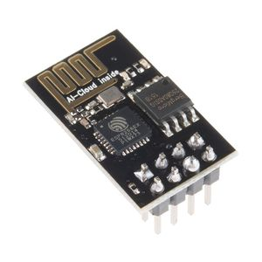

Micropython With ESP8266
for the Internet of Things

Slide 2
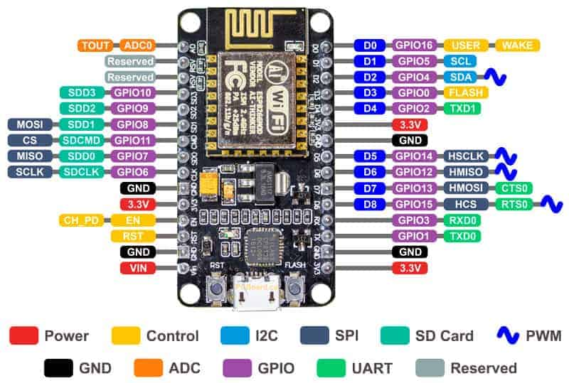
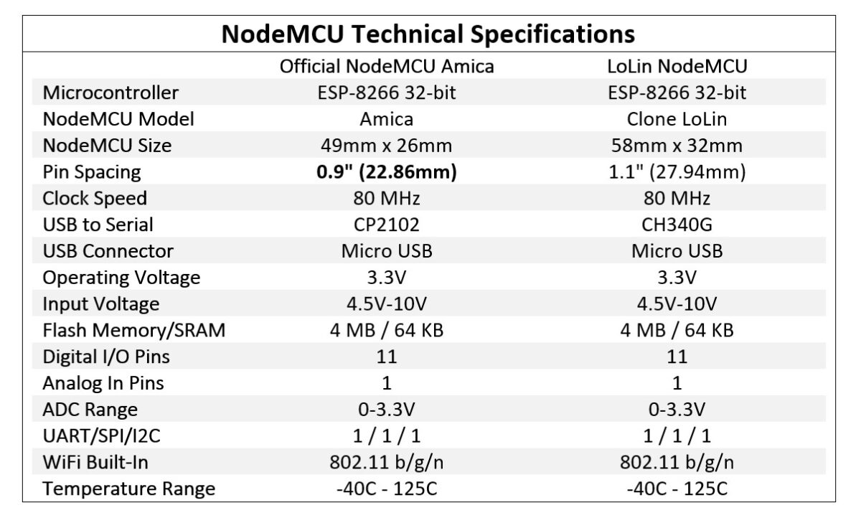

Slide 3
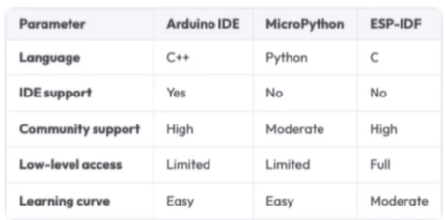

Slide 4
Frimeware
Stable firmware builds
The minimum requirement for flash size is 1Mbyte
Notes:
https://docs.micropython.org/en/latest/esp8266/tutorial/intro.html#intro

Slide 5
Install driver of ESP8266 on windows
Install firmware
Notes:
ESP8266 CH340 Driver :
https://cdn.sparkfun.com/assets/learn_tutorials/8/4/4/CH341SER.EXE
Cp210x Driver :
https://www.silabs.com/developers/usb-to-uart-bridge-vcp-drivers
ESP8266 Firmware :
https://micropython.org/download/#esp8266

Slide 6
THANK YOU

